Slide 1
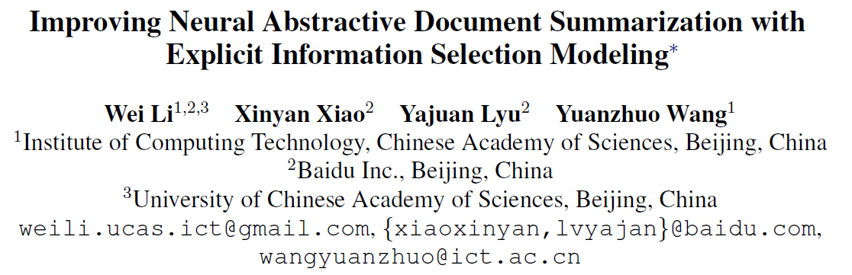
EMNLP 2018

Slide 2
Two Prominent Approaches to Summarization
Extractive Approach
Select salient parts (usually sentences) of the original text from a summary
Pros:
Easier
Producing fluent sentences
Preserving the meaning of the original text
Cons:
Information redundancy
Incoherence between sentences
Abstractive Approach
General novel sentences using arbitrary words and expressions
Pros:
More flexible
Human does in this way
Preserving the meaning of the original text
Cons:
Information redundancy
Incoherence between sentences

Slide 3
Key Factors of Abstractive Document Summarization
Fluency
Neural generation models (e.g., RNN based seq2seq models) are able to generate fluent text
Novelty
Distraction mechanism (Chen et al. 2016)
Coverage mechanism (See et al. 2017)
Coherence
Hierarchical Models (Li et al., 2015; Li et al., 2018; Cohan et al., 2017)
Saliency
Very few neural models consider the saliency factor
Is it necessary to model it and optimize it explicitly?
And how?
Notes:
Saliency: 显著性

Slide 4
Basic Encoder-Decoder Framework for Abstractive Document Summarization
Implicitly model the information selection process via end-to-end training
First encodes the input into an abstract representation
Then decodes the output based on the encoded information
Difficult to learn the process of salient information selection in document summarization
End-to-End learning System
Encoder
Decoder
Even worse than Extractive Methods!
Input
Output

Slide 5
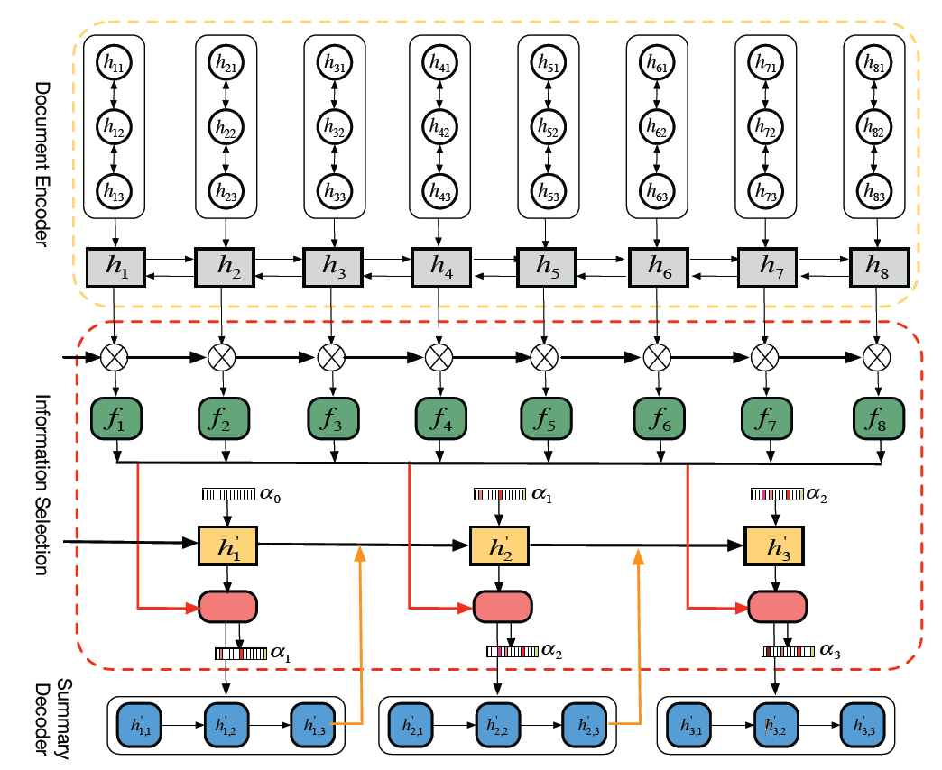
Encoder-Selection-Decoder Framework
Hierarchical Document Encoder
Word-level Bi-GRU encoder
Sentence-level Bi-GRU encoder
Information Selection Layer
Global Information Filtering
Filtering Gate
Local Sentence Selection
RNN Sequence Prediction
Summary Sentence Generator
Uni-GRU Decoder

Slide 6
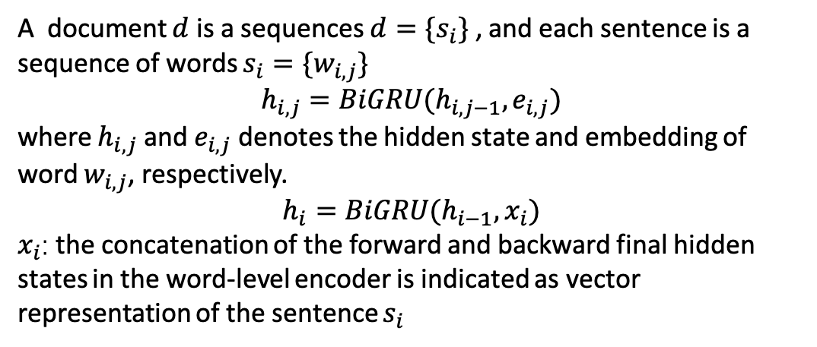
Encoder-Selection-Decoder Framework
Hierarchical Document Encoder
Word-level Bi-GRU encoder
Sentence-level Bi-GRU encoder
A document $d$ is a sequences $d=\{s_{i}\}$ , and each sentence is a sequence of words $s_{i}=\{w_{i,j}\}$
$$h_{i,j}=BiGRU(h_{i,j−1}, e_{i, j})$$
where $h_{i,j}$ and $e_{i,j}$ denotes the hidden state and embedding of word $w_{i,j}$, respectively.
$$h_{i}=BiGRU(h_{i−1}, x_{i})$$
$x_{i}$: the concatenation of the forward and backward final hidden states in the word-level encoder is indicated as vector representation of the sentence $s_{i}$

Slide 7
Encoder-Selection-Decoder Framework
Hierarchical Document Encoder
Word-level Bi-GRU encoder
Sentence-level Bi-GRU encoder
Information Selection Layer
Global Information Filtering
Filtering Gate
Local Sentence Selection
RNN Sequence Prediction

Slide 8
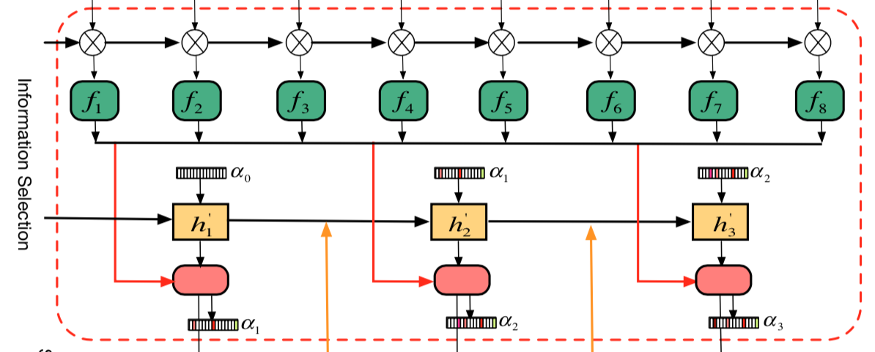
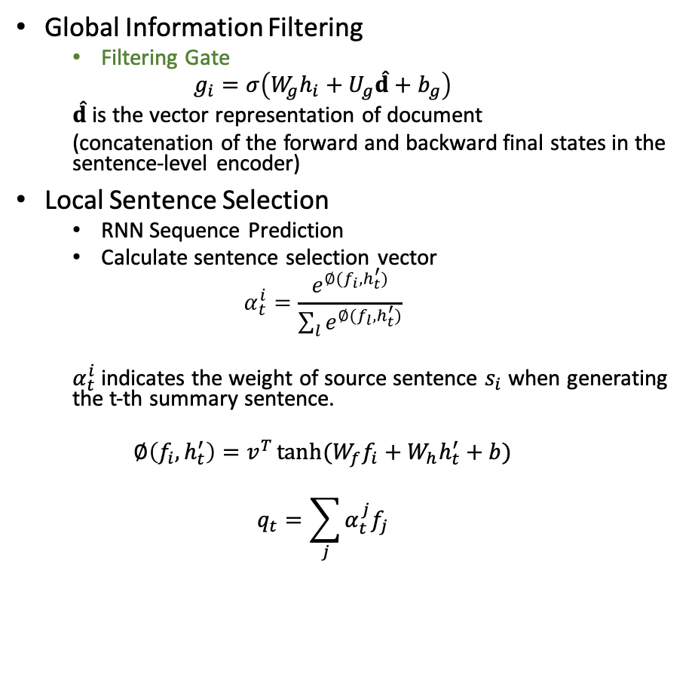
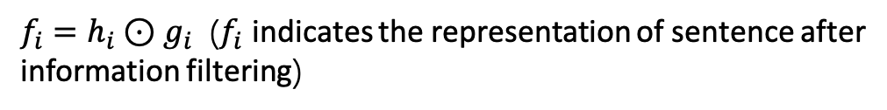
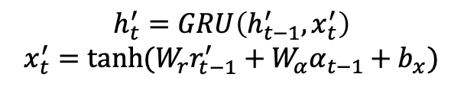
Information Selection Layer
Global Information Filtering
Filtering Gate
$$g_{i}=σ\left(W_{g}h_{i}+U_{g}\hat{d}+b_{g}\right)$$
$\hat{d}$ is the vector representation of document
(concatenation of the forward and backward final states in the sentence-level encoder)
Local Sentence Selection
RNN Sequence Prediction
Calculate sentence selection vector
$$α_{t}^{i}=\frac{e^{∅(f_{i},h_{t}^{′})}}{\sum_{l}{e^{∅(f_{l},h_{t}^{′})}}}$$
$α_{t}^{i}$ indicates the weight of source sentence $s_{i}$ when generating the t-th summary sentence.
$$∅\left(f_{i},h_{t}^{′}\right)=v^{T}\tanh{(W_{f}f_{i}+W_{h}h_{t}^{′}+b)}$$
$$q_{t}=\sum_{j}{α_{t}^{j}f_{j}}$$
$f_{i}=h_{i}⊙g_{i}$ ($f_{i}$ indicates the representation of sentence after information filtering)
$$h_{t}^{′}=GRU\left(h_{t−1}^{′}, x_{t}^{′}\right)$$
$$x_{t}^{′}=\tanh{(W_{r}r_{t−1}^{′}+W_{α}α_{t−1}+b_{x})}$$
$r_{t−1}^{′}$: representation of previous generated sentence
Notes:
人们在写文本摘要的时，会首先跳过和删除文本中无用的信息。根据这种思想，作者提出了信息选择网络。全局信息的筛选
是从微语义的维度而不是筛选整个句子。

Slide 9
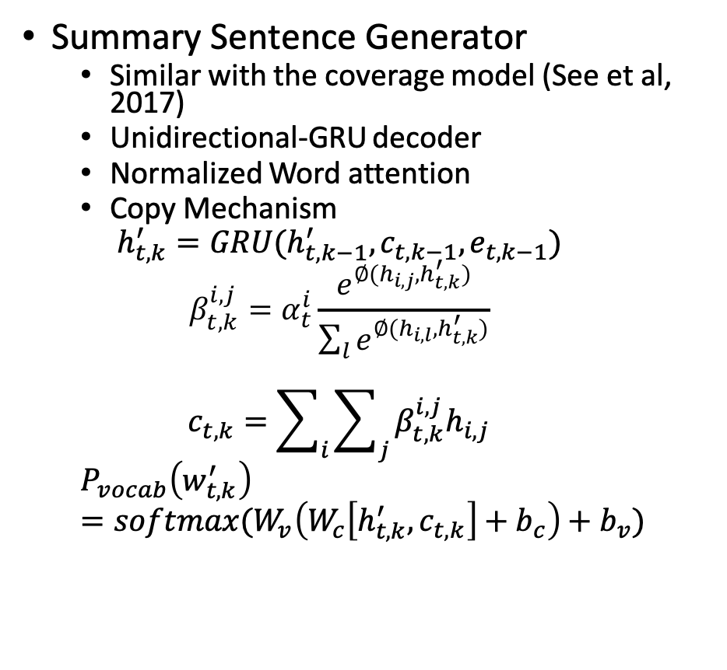
Encoder-Selection-Decoder Framework
Summary Sentence Generator
Similar with the coverage model (See et al, 2017)
Unidirectional-GRU decoder
Normalized Word attention
Copy Mechanism
$$h_{t,k}^{′}=GRU(h_{t,k−1}^{′},c_{t,k−1},e_{t,k−1})$$
$$β_{t,k}^{i,j}=α_{t}^{i}\frac{e^{∅(h_{i,j},h_{t,k}^{′})}}{\sum_{l}{e^{∅(h_{i,l},h_{t,k}^{′})}}}$$
$$c_{t,k}=\sum_{i}{\sum_{j}{β_{t,k}^{i,j}h_{i,j}}}$$
$$P_{vocab}\left(w_{t,k}^{′}\right)=softmax(W_{v}\left(W_{c}\left[h_{t,k}^{′},c_{t,k}\right]+b_{c}\right)+b_{v})$$

Slide 10
Distant-supervised optimization
Summary Sentence Generator
Similar with the coverage model (See et al, 2017)
Unidirectional-GRU decoder
Normalized Word attention
Copy Mechanism
$$h_{t,k}^{′}=GRU(h_{t,k−1}^{′},c_{t,k−1},e_{t,k−1})$$
$$β_{t,k}^{i,j}=α_{t}^{i}\frac{e^{∅(h_{i,j},h_{t,k}^{′})}}{\sum_{l}{e^{∅(h_{i,l},h_{t,k}^{′})}}}$$
$$c_{t,k}=\sum_{i}{\sum_{j}{β_{t,k}^{i,j}h_{i,j}}}$$
$$P_{vocab}\left(w_{t,k}^{′}\right)=softmax(W_{v}\left(W_{c}\left[h_{t,k}^{′},c_{t,k}\right]+b_{c}\right)+b_{v})$$

Slide 11
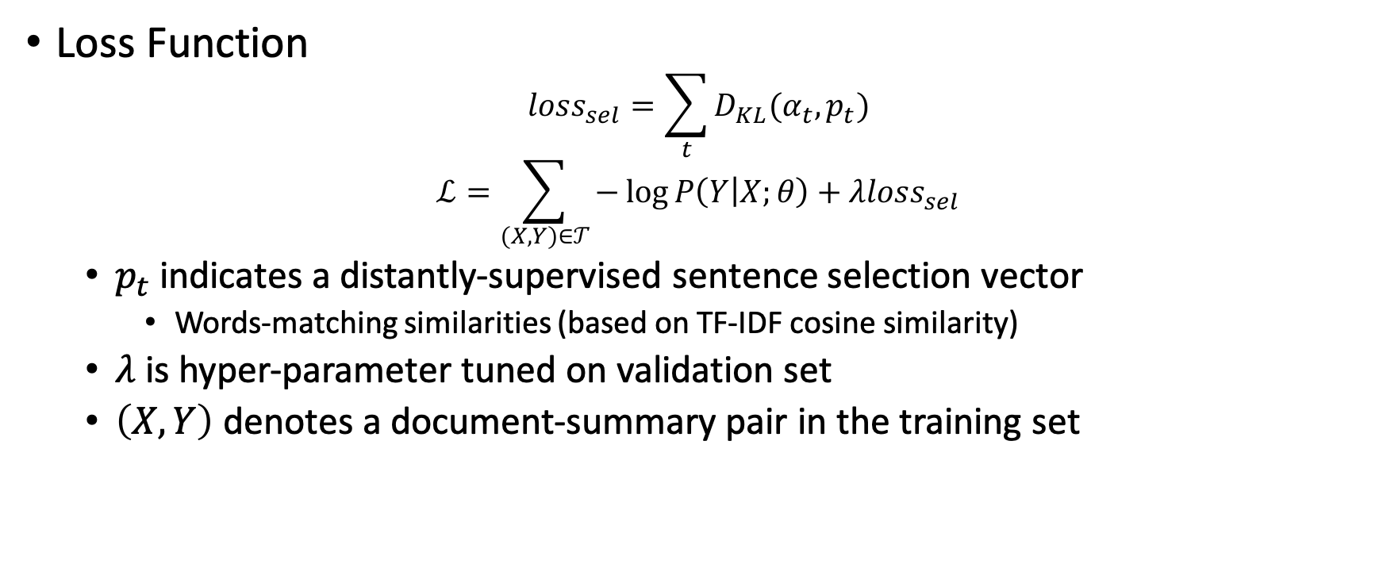
Distant-supervised optimization
Loss Function
$$loss_{sel}=\sum_{t}{D_{KL}(α_{t},p_{t})}$$
$$ℒ=\sum_{(X,Y)∈𝒯}{−\log{P\left(Y | X;θ\right)+λloss_{sel}}}$$
$p_{t}$ indicates a distantly-supervised sentence selection vector
Words-matching similarities (based on TF-IDF cosine similarity)
$λ$ is hyper-parameter tuned on validation set
$\left(X, Y\right)$ denotes a document-summary pair in the training set

Slide 12
Experiment Details
Dataset
CNN/DailyMail: 280,125 training pairs, 13,367 validation pairs and 11,489 test pairs
Baseline
Extractive models
SummaRuNNer(Nallapati et al., 2017)
SummaRuNNer-abs
Lead-3
Abstractive models
Seq2seq-baseline (See et al., 2017)
ABS-temp-attn (Nallapati et al., 2016)
Graph-attention (Tan et al., 2017)
Deep-reinforced (Paulus et al., 2017)
Coverage (See et al., 2017)

Slide 13
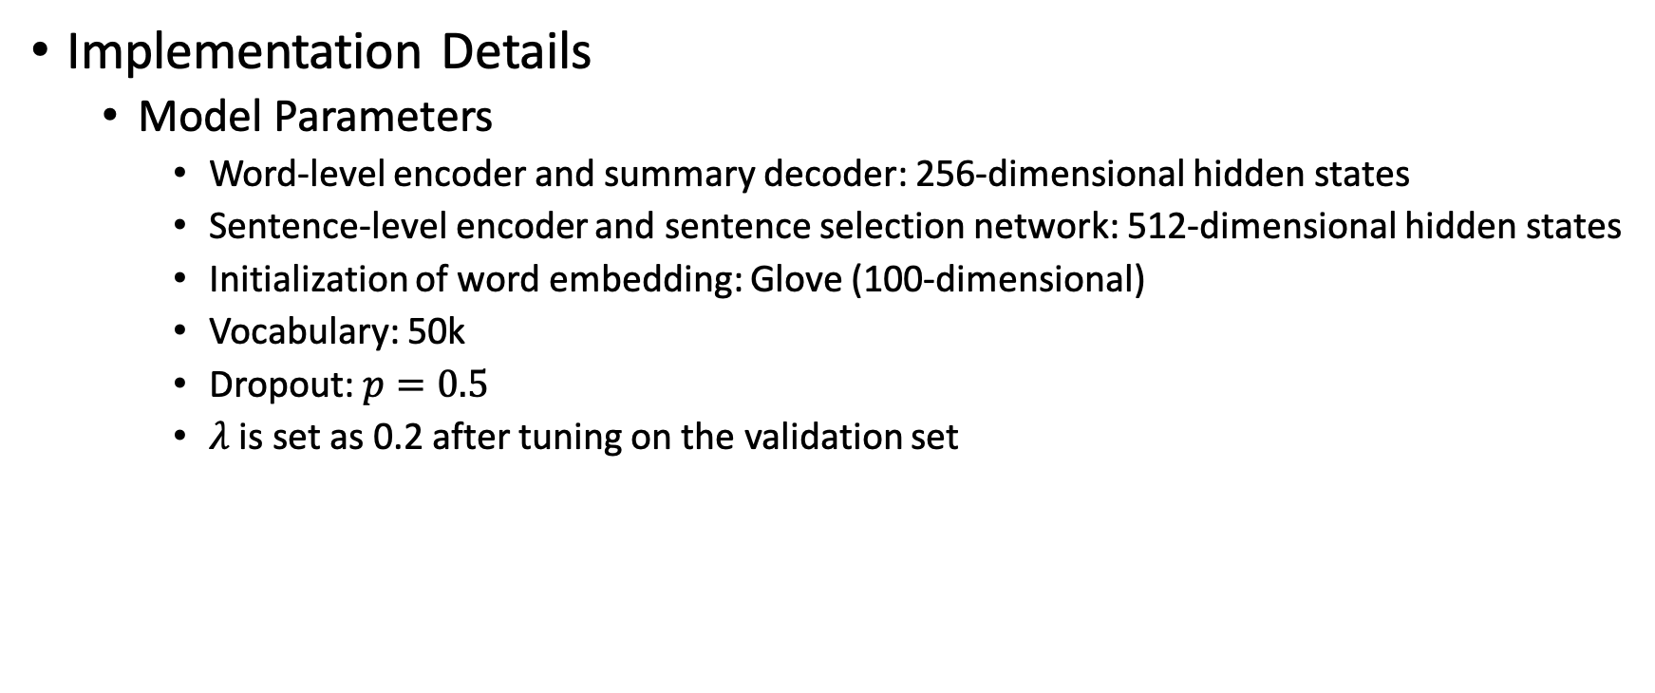
Experiment Details
Implementation Details
Model Parameters
Word-level encoder and summary decoder: 256-dimensional hidden states
Sentence-level encoder and sentence selection network: 512-dimensional hidden states
Initialization of word embedding: Glove (100-dimensional)
Vocabulary: 50k
Dropout: $p=0.5$
$λ$ is set as 0.2 after tuning on the validation set

Slide 14
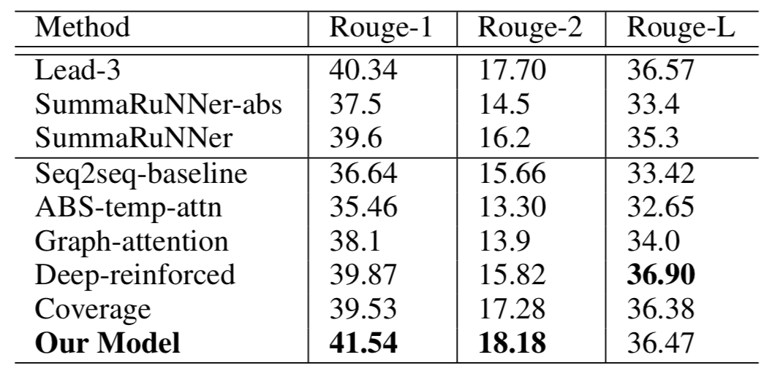
Results
ROUGE compares the machine-generated summary to the human-written reference summary by counting the co-occurrence of 1–grams, 2-grams, and longest comment sequence.
Extractive methods
Abstractive methods
Notes:
Note that, the Deep-reinforced model achieves the best ROUGE-L performance because it directly opti- mizes the ROUGE-L metric.

Slide 15
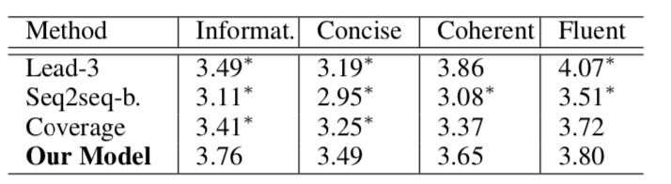
Human Evaluation Results
50 random samples from CNN/DailyMail test set
Three data annotators compare the generated summaries with reference summaries independently
Informative: How informative the summary is?
Concise: How concise the summary is?
Coherent: How coherent (between sentences) the summary is?
Fluent: How fluent, grammatical the sentences of a summary are?
Each property is assessed with a score from 1(worst) to 5(best)
More informative and concise
* indicates the difference between Our Model and other models are statistic significant (p < 0.1) by two-tailed t-test.

Slide 16
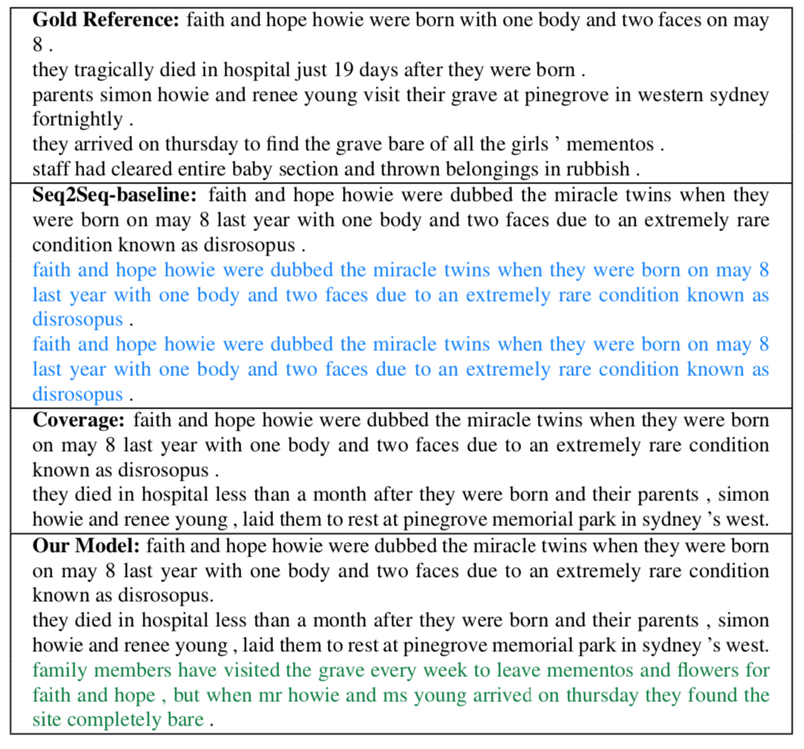
Case Analysis
Seq2Seq generates repeated sentences and loses salient information.
The Coverage model reduces repetitions, but also loses salient information (e.g., “mementos” and “family members visit the grave”).

Slide 17
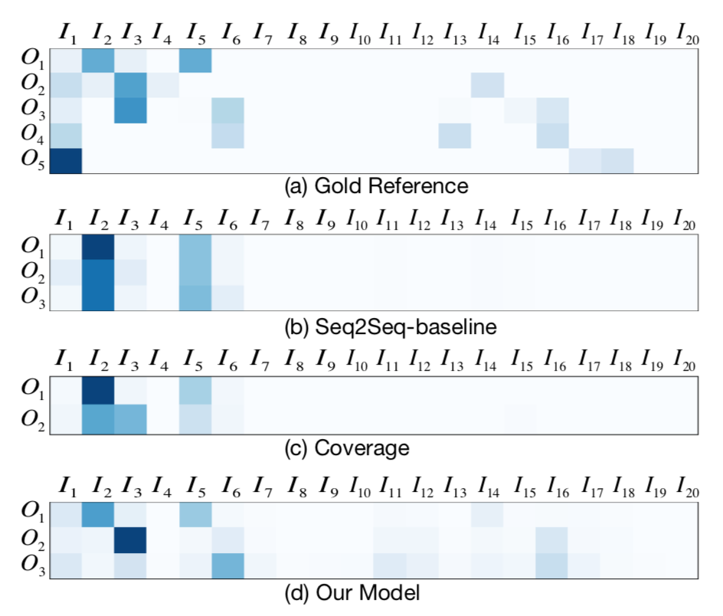
Case Analysis
Visualization of sentence selection vector
Seq2Seq fails to detect all important source sentences and attend to the same sentences repeatedly.
Coverage learns to reduce repetitions, but fails to detect all the salient information.

Slide 18
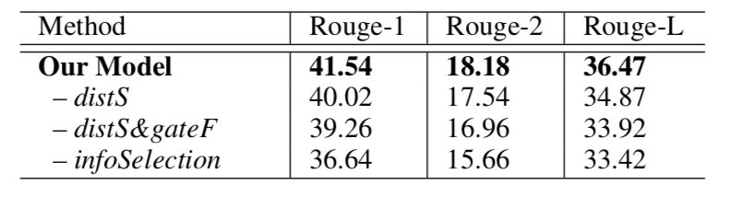

Effectiveness of Information Selection Modeling
Model Validation
-distS: removing the distant supervision for sentence selection ($λ=0$)
-distS&gateF: removing both distant supervision and the global gated information filtering component.
-infoSelection: actually the Seq2seq-baseline model

Slide 19
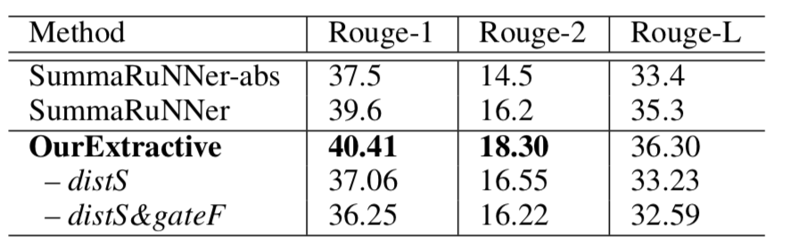
Effectiveness of Information Selection Modeling
Extractive Methods
OurExtractive
Replaces the summary decoder by a sentence extractor
Extracts the source sentence with largest weight in each sentence generation step.

Slide 20
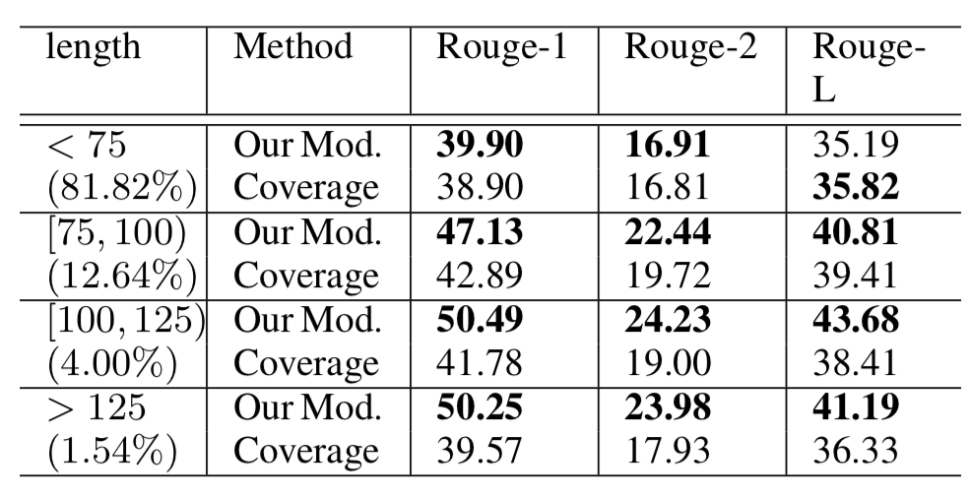
Effectiveness of Information Selection Modeling
Comparison results w.r.t different length of reference summary
As the summary becomes longer, our system will obtain larger advantages over the baseline

Slide 21
Conclusion & Future Work
Conclusion
Explicitly modeling and optimizing the information selection process is effective and necessary
Our encode-selection-decoder framework is effective for neural document summarization
Future Work
Explore more meaningful information selection unit, such as subtopic, other discourse units.

